Slide 1

Machine Learning Lite!
Microsoft Azure Machine Learning Studio

Slide 2

What is this talk?

Slide 3

Who am I? Why this talk?

Slide 4

Part 1 : Machine Learning Overview

Slide 5
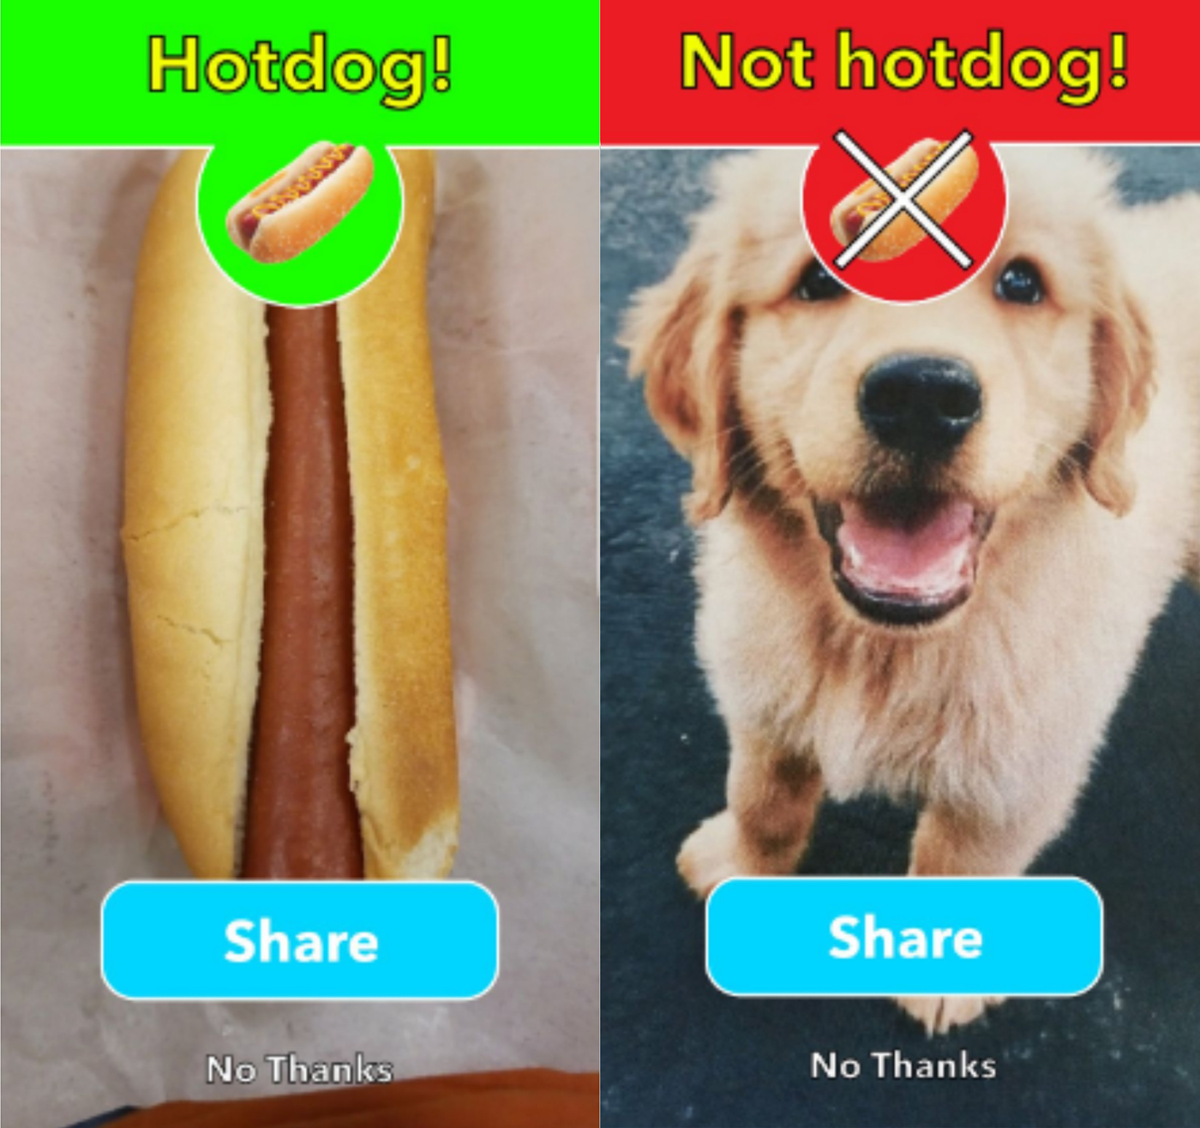
What is Machine Learning used for?

Slide 6
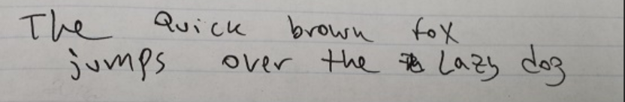

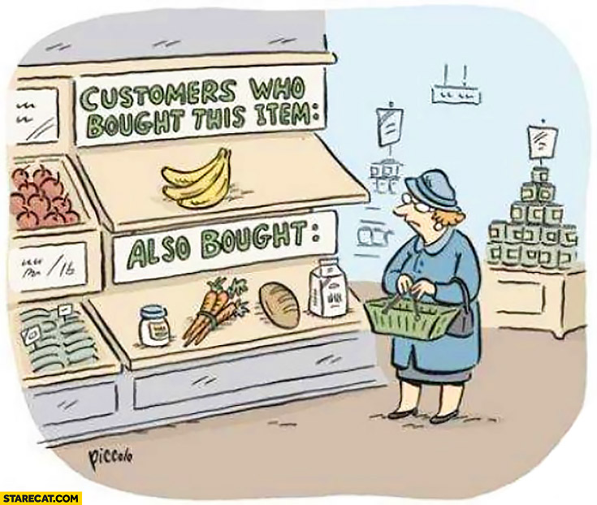
What is ML used for?
Handwriting Recognition
Loan Approval
We think you might like this!
Notes:
USPS processes 500M pieces of mail a day. About 5M of those pieces are still illegible.

Slide 7
Defining Machine Learning
Anyone want to take a shot?

Slide 8
Defining Machine Learning
Anyone want to take a shot?
Building a model from example inputs to make data driven predictions.

Slide 9
Defining Machine Learning
Anyone want to take a shot?
Building a model from example inputs to make data driven predictions.
vs.

Slide 10
Defining Machine Learning
Anyone want to take a shot?
Building a model from example inputs to make data driven predictions.
vs.
Following a set of static programming instructions.

Slide 11

Types of Machine Learning

Slide 12
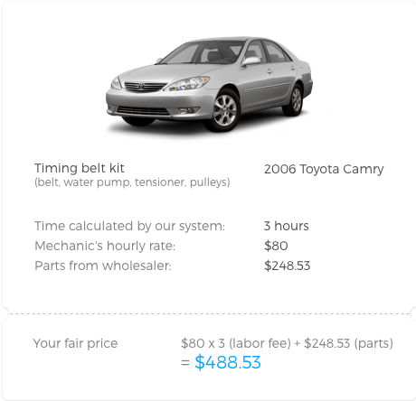
Supervised
Training a model to predict a specific value based on a set of inputs.
Notes:
Using previous data to make future value predictions. Except for the K-Means Clustering algorithm, all of the ML Studio algorithms are supervised.

Slide 13
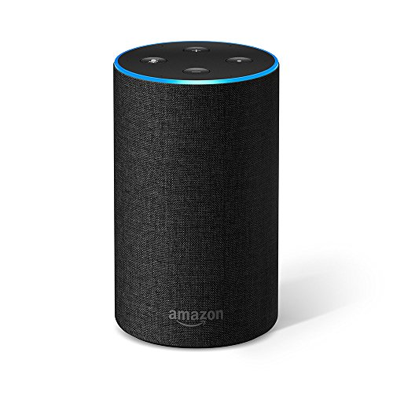
Unsupervised
Training a model to find clusters of like values.
Notes:
Using data points with no labels associated. I.E. Learning the voice of a person so that the application will only respond to that person.

Slide 14
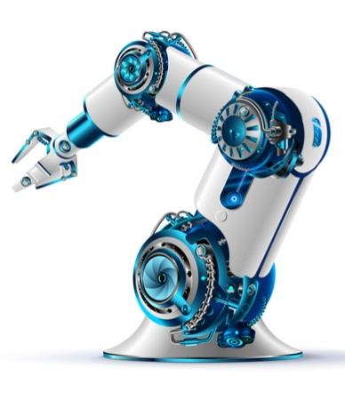
Reinforcement
Training a model based on rewards for correct behavior.
Notes:
Used in robotics and IoT applications. I.E. Receive a set of sensor readings and make a decision based on those inputs. Later, a reward is given based on how correct the decision was. As rewards are collected, the model modifies itself to get better rewards.

Slide 15
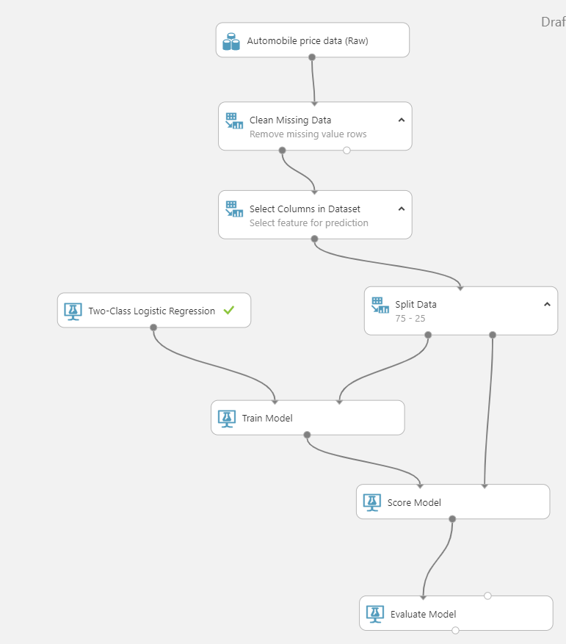
Machine Learning Workflow
Get Data
Modify Data
Select Algorithm
Train Model
Evaluate

Slide 16

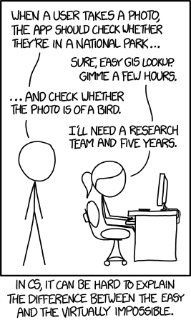
Ask solvable questions
Notes:
If you are asked to predict what the department’s budget will be for next month, you might be able to reasonably predict an answer. If you are asked if the department will make budget next month, that may be much, much harder to predict.

Slide 17

Don’t force it!

Slide 18
Part 2 : Azure ML Studio

Slide 19

Azure ML Studio
What is it?
What does it do?
Why use it?
Notes:
Allows you to manage your data, build an ML solution, deploy the solution, control access, and update the solution. It is a full IDE for machine learning solutions. Supports all phases of solution development and deployment. No programming required but R/Python/SQL are supported. Drag and drop interface.

Slide 20
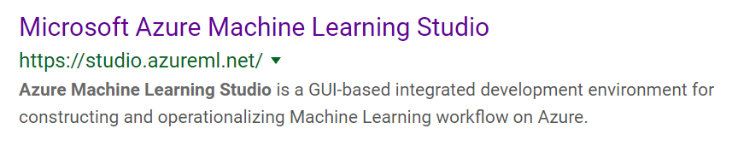
Getting Started: ML Trial
https://studio.azureml.net/Home
Notes:
Check out studio.azureml.net

Slide 21
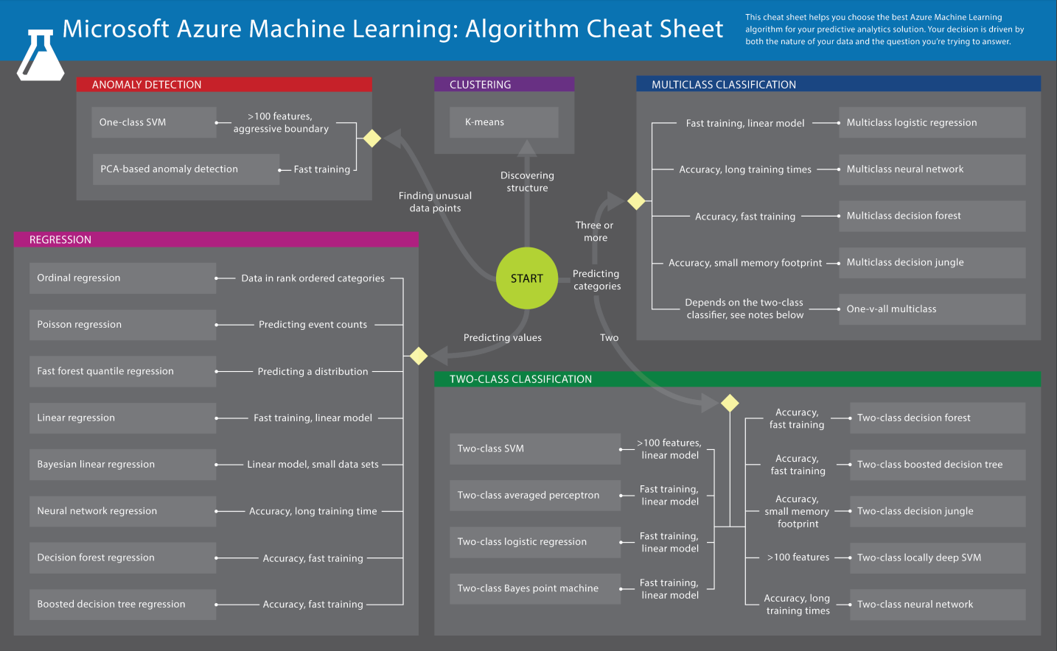
Picking an Algorithm? Use the cheat sheet!

Slide 22
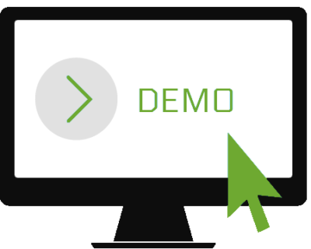

Slide 23
THANK YOU!
Questions?

